Slide 1
Notes on slidecrafting for Kodiak
Ignore technical jargon (“simulation”, “optimization” etc.) to the extent possible
Emphasis on practical/useful results
1-3 Key takeaways per results slide
Results rolled up at the front of the results template deck on the BLUF slide (Slide 10)
Please modify the slide titles with your model’s name and results as needed
Please send your slides securely by: 6/21/2023

Slide 2
Draft Agenda

Slide 3
ERMA Kodiak Review Technical Modeling Overview
Session A

Slide 4


Workflow to evaluate habitability in buildings
Building selection
Identify buildings that are mission critical and modeling needs
Energy modeling & calibration
Generate building energy models using OpenStudio and EnergyPlus leveraging DOE prototype models
Calibrate the models using the actual energy consumption and weather data
Habitability metric
Identify thermal performance metric using PMV to evaluate the habitability
Habitability evaluation
Run simulations during the power and steam outage period and evaluate the habitability

Slide 5
Buildings for energy modeling
Building​ | Brief description of the building and of its purpose. | Year Built | Year Last Retrofit | Gross floor area [ft2] | Height [ft] | Window to Wall ratio | Insulation ASHRE code | Main Electric Loads | HVAC system type
N96 GSE ADMIN BLDG​ | Stores fuel trucks and LOX equipment. | 2002 | N/A | 4,390 | 18 | 15.0% | 90.1 2004 | warehouse | district heating with AHU + VAV
14 HANGAR 1 | Stores C-130 aircraft, supports maintenance, washing, and crew | 1940 | 1995 1997 | 89,280 | 46 | 15.0% | 90.1 1989 | warehouse, engineering shop | district heating with AHU + VAV
20 HANGAR 2​ | Retired hangar, Base Operations Support contractor, aircraft supply, and Airstation Command reside there now. | 1940 | 2017 | 70,000 | 60 | 15.0% | 90.1 2017 | warehouse, office | district heating with AHU + VAV
15 HANGAR 3​ | Stores C-130/H-60, and H-65 aircraft, supports maintenance, washing, and crew | 1940 | 2001 | 97,020 | 61 | 15.0% | 90.1 2004 | warehouse, engineering shop | district heating with AHU + VAV
N23 WATER TREATMENT PLANT​ | Treats water | 1980 | 2012 | 1,292 | 12 | 0.0% | 90.1 2010 | lab | Electric Heating
N2 SEWAGE TREATMENT PLANT BLDG​ | Treats waste water | 1974 | 2007 | 7,200 | 20 | 5.0% | 90.1 2007 | lab | district heating
614 CUTTERMAN'S CLUB/AUTO HOBBY​ | Supports ship's crew in port for laundry, internet, gym, as well as personal auto maintenance | 1965 | 1983 1986 | 8,100 | 30 | 5.0% | post-1980 | warehouse | district heating
N73 CUTTER STORAGE WAREHOUSE​ | Supports light ships maintenance and ship dry storage | 1992 | 2001 2010 | 10,150 | 20 | 5.0% | 90.1 2010 | warehouse, office | district heating with AHU + VAV
R2 RECEIVER BLDG​ | Supports Critical Communications | 1956 | 1988 | 1,628 | 10 | 5.0% | post-1980 | office, communication | district heating with AHU + VAV
T1 TRANSMITTER BLDG (COMMSTA)​ | Supports offices that support IT and communication for the base. | 1951 | 1988 | 14,468 | 20 | 5.0% | post-1980 | office, communication | district heating with AHU + VAV

Slide 6
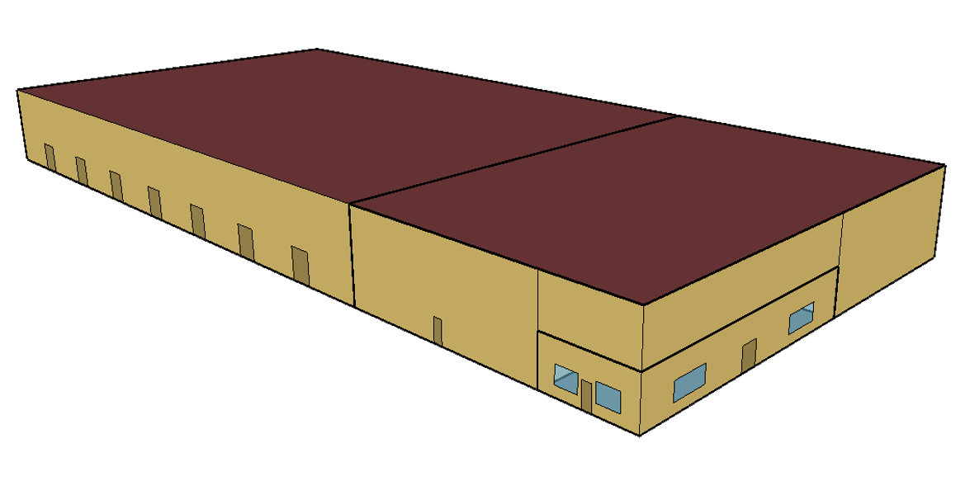
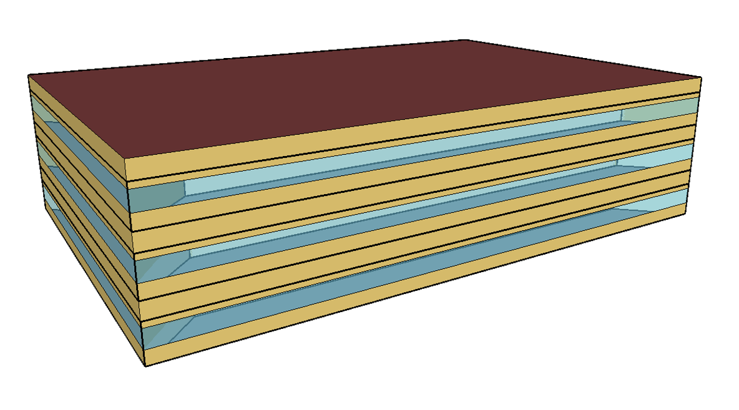
Building energy models and thermal comfort metric
Building Energy Models
Thermal Comfort Metric
We used OpenStudio and EnergyPlus to develop energy models
We leveraged DOE prototype energy models of building types:
We calibrated the models using the 2020 electricity meter data and actual weather data based on the ASHRAE 14 Guideline
We used Predicted Mean Vote (PMV) to evaluate thermal comfort for occupants in buildings guided by ISO17772-1, and ASHRAE 55
PMV is an index that predicts the mean value of the votes of a large group of persons on a thermal sensation scale ranging from -3 (cold) to +3 (hot)
PMV is derived based on:
Indoor air temperature and mean radiant temperature
Average air speed
Clothing insulation
Metabolic rate
A building is habitable if:
-3 <= PMV <= 3
A building is not habitable if:
PMV < -3 or PMV > 3
Warehouse
Office

Slide 7
Modeling results: Habitability hours #1
Power and steam availability was added to the thermal comfort evaluation
Building indoor temperature changes as outdoor climate condition changes
Indoor air temperature reflects the building’s thermal inertia
If buildings do not have power and steam to maintain the heating setpoint temperature during the winter season, buildings get cold, and after some hours from an outage, there are hours PMV < -3
Power outage implies heating outage.
For example, outage from tsunami in:
#1 in winter: Many hours are not habitable
#2, #3 in summer: Many hours are habitable

Slide 8
Modeling results: Habitability hours #2
For example, 614 Cutterman has 2,311 power outage hours, but 1,322 hours are thermally habitable.

Slide 9
Key Assumptions & Limitations
The building energy models were calibrated based on the monthly electricity meter data for 2020. The building modeling conditions may differ from the actual building usage and operation.
We used the typical meteorological year weather data (TMY3) reflecting 1991 – 2005 years, which may not reflect the current climate conditions. TMY3 is the industry standard to reproduce typical weather conditions.
We evaluated habitability based on PMV-based thermal comfort. Occupants’ high-insulation clothing can help winter habitability
We considered average PMV across all rooms. Some rooms might reach the PMV threshold sooner or later than the average.

Slide 10
Questions for Kodiak
Do you consider any other indoor environmental performance metrics when evaluating habitability?
Do you consider people can occupy for missions during the power outage condition?

Slide 11
ERMA Kodiak Review Scenario Results
Session B

Slide 12
BLUF: Main Takeaways
5 slides max per team
Summarize key takeaways from the following slides

Slide 13
Re-introduction to Model
This is a reminder only for content from Session A (Approximately 15 seconds)

Slide 14
Scenario Results
Insightful findings that provide one or more practical result(s) that are actionable
Ex: “If a tsunami warning comes in winter time, use the few hours before the tsunami arrives to heat buildings to maximum allowable temperature”
Ex: “If I add one more stationary or portable generator to my fleet at location X, then my mission availability improves by Y%”
Minimize technical jargon

Slide 15
Scenario Results Continued

Slide 16
Scenario Results Continued

Slide 17
Questions for Kodiak

